Slide 1

Image Inpainting using Deep Learning
End Sem Project Evaluation (Roll Number:- 184070024)
By
Kavitha Viswanathan
Course
CS726

Slide 2
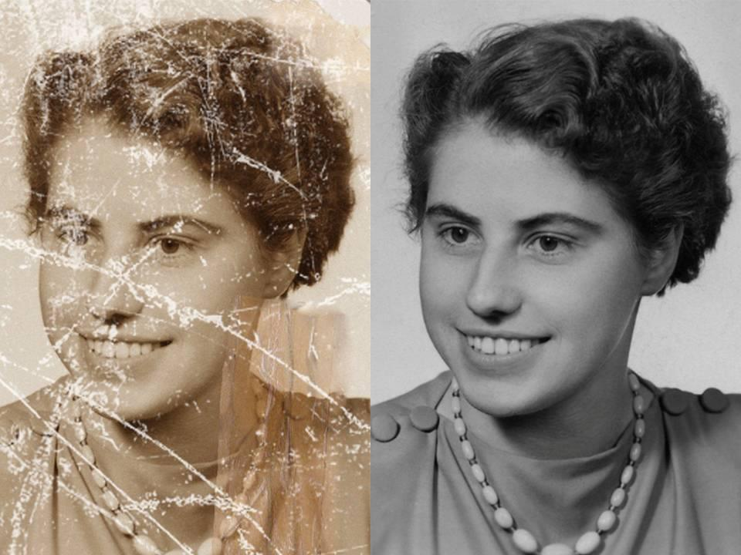
Problem Statememt
Auto-Encoder
Pconv
Wavemix
Deep Image Prior
Conclusion
Image inpainting refers to recreation of a damaged image or alternatively can be extended to discard an unwanted part of an image
https://medium.com/jamieai/image-inpainting-with-deep-learning-dd8555e56a32

Slide 3
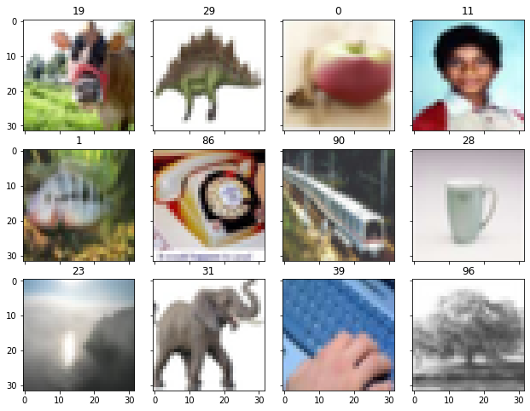
Problem Statement
Auto-Encoder
Pconv
Wavemix
Deep Image Prior
Conclusion
Dataset Used- CIFAR100: Here

Slide 4
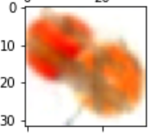
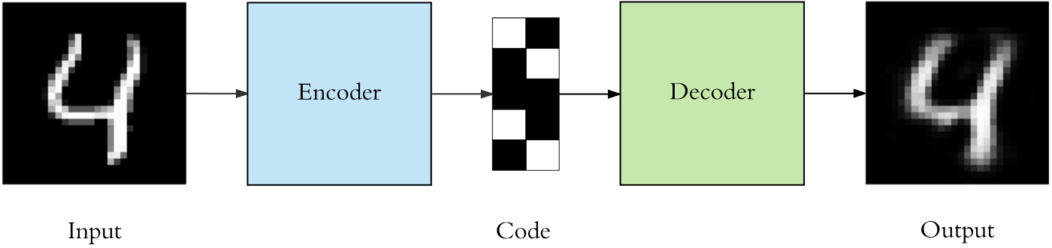
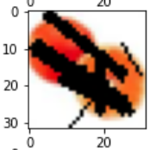
Auto-Encoder
Pconv
Wavemix
Deep image Prior
Conclusion
Problem Statement
AutoEncoder
Fig 1: AutoEncoder for Image Inpainting
https://towardsdatascience.com/applied-deep-learning-part-3-autoencoders-1c083af4d798

Slide 5
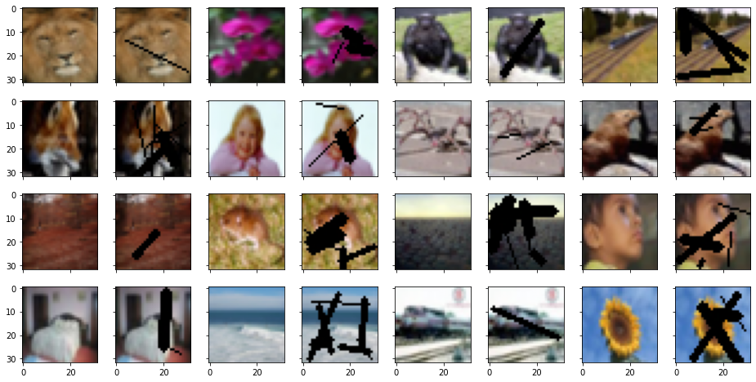
Auto-Encoder
Pconv
Wavemix
Deep image Prior
Conclusion
Problem Statement
Fig 2: Training Images for Image Inpainting

Slide 6
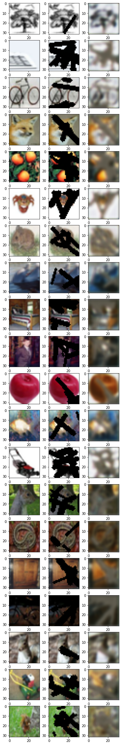
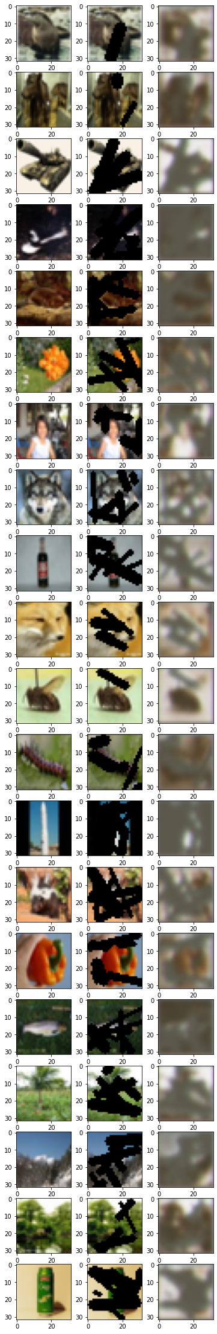
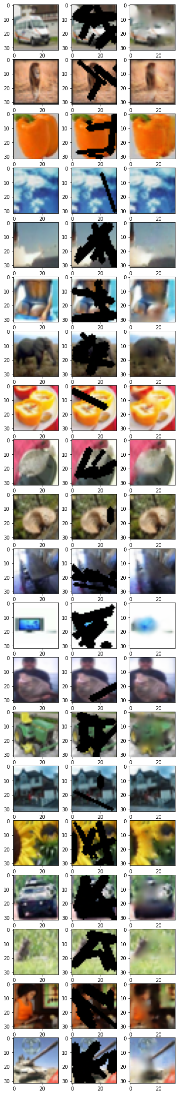
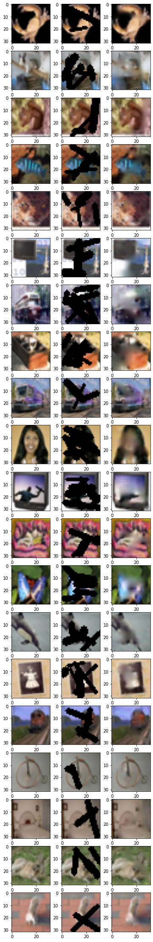
Auto-Encoder
Pconv
Wavemix
Deep image Prior
Conclusion
Problem Statement
Fig 3. Results of AutoEncoder with a. MAE,sgd b. MSE, sgd c. MAE, adam d. MSE,adam

Slide 7
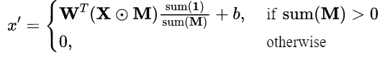
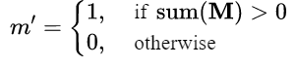
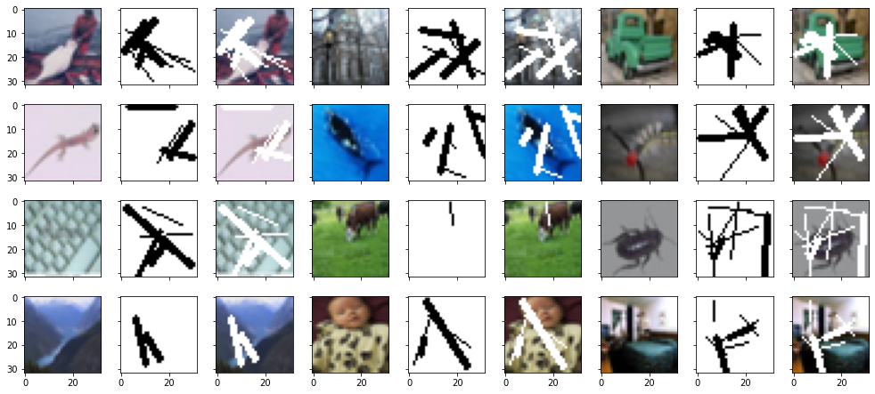
Auto-Encoder
Pconv
Wavemix
Deep image Prior
Conclusion
Problem Statement
Partial Convolution
Fig 4: Training Images for Image Inpainting
https://wandb.ai/site/articles/introduction-to-image-inpainting-with-deep-learning

Slide 8
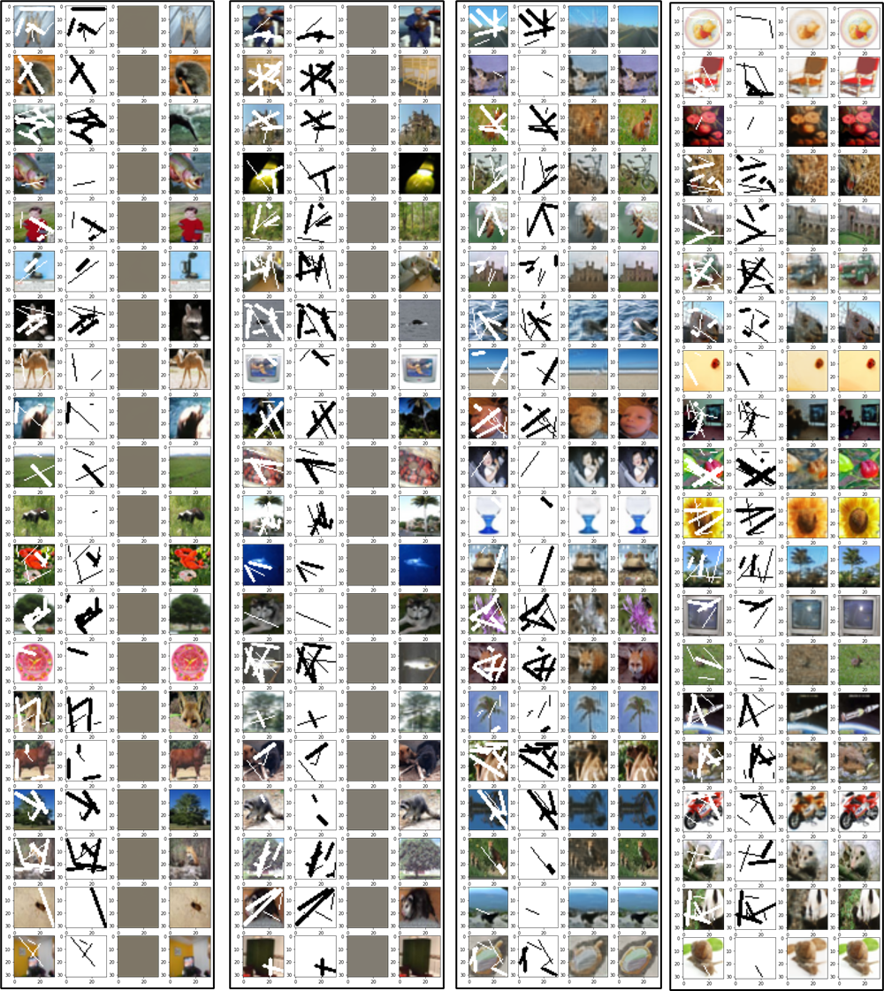
Auto-Encoder
Pconv
Wavemix
Deep image Prior
Conclusion
Problem Statement
Fig 5: Results of Pconv with a. MAE,sgd b. MSE, sgd c. MAE, adam d. MSE,adam

Slide 9
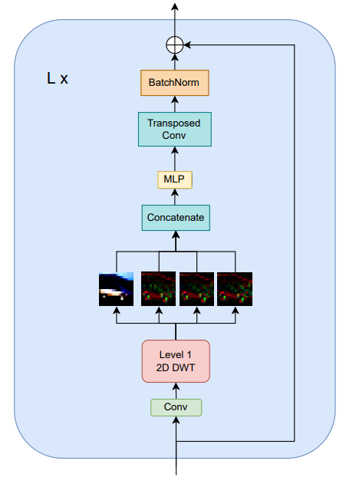
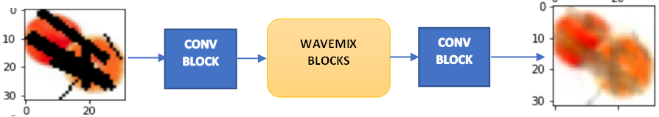
Auto-Encoder
Pconv
Wavemix
Deep image Prior
Conclusion
Problem Statement
Wavemix
Fig 6. WaveMix Architecture for image inpainting
Resource Efficient
Low training parameters and high speed
Wavemix: resource-efficient token mixing for images- Pranav Jeevan, Amit Sethi

Slide 10
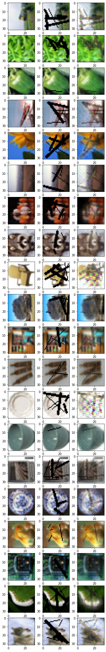
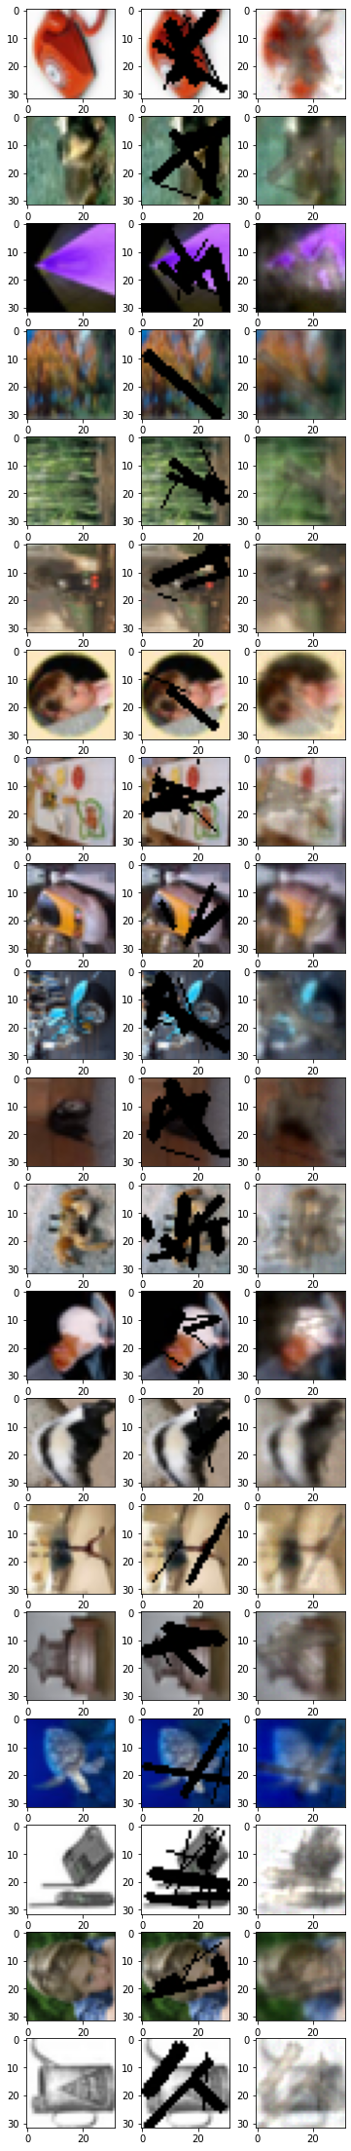
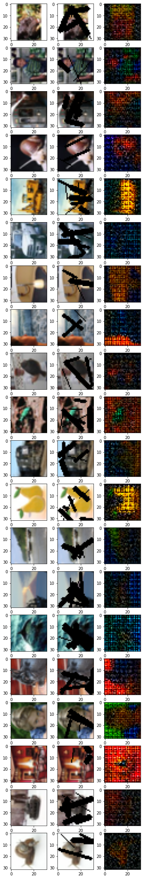
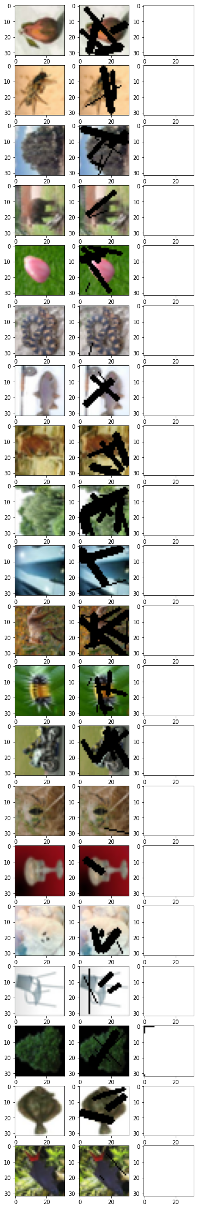
Auto-Encoder
Pconv
Wavemix
Deep image Prior
Conclusion
Problem Statement
Fig 7. Results of Wavemix with a. MAE b. MSE, adam c. cross-entropy loss, adam d. dice loss

Slide 11
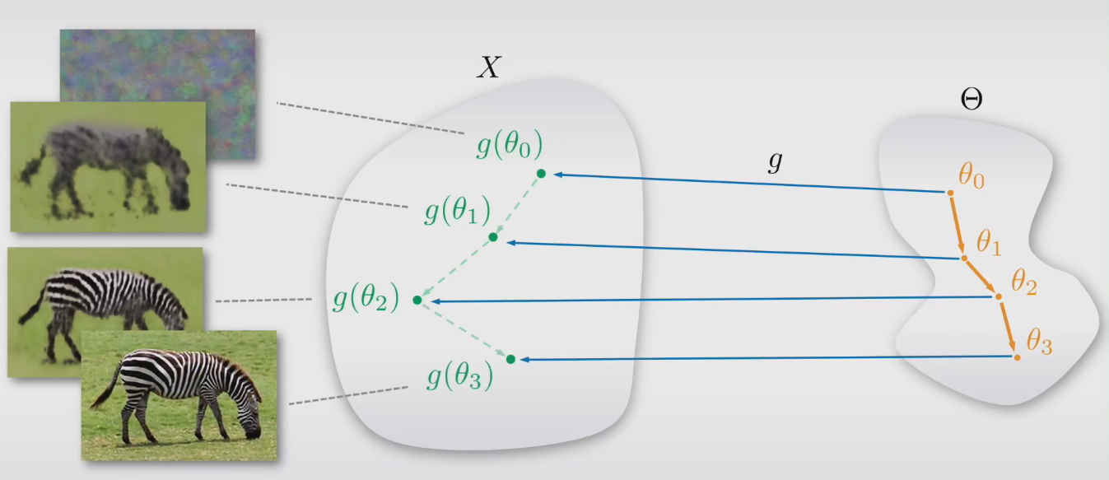
Auto-Encoder
Pconv
Wavemix
Deep image Prior
Conclusion
Problem Statement
Deep Image Prior
Fig 8. General Idea of Deep Image Prior

Slide 12
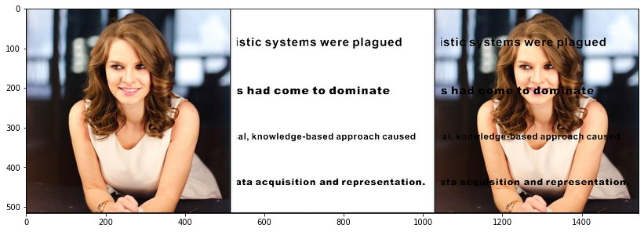
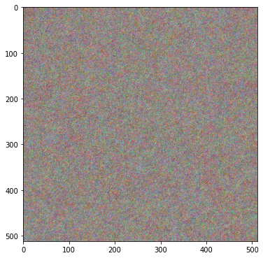
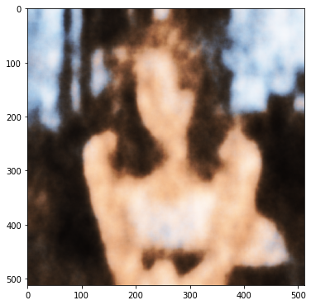
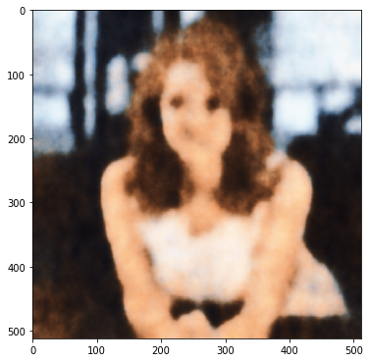
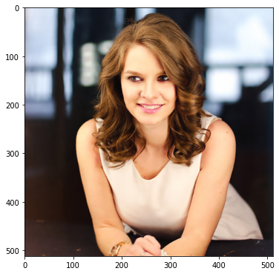
Auto-Encoder
Pconv
Wavemix
Deep image Prior
Conclusion
Problem Statement
Results on Original Dataset
Fig 9: Input Image for Image Inpainting using Deep Image Prior (right most image)
Fig 10. Results of Deep Image Prior on original dataset on 0th ,50th, 100th and 6000th iteration

Slide 13
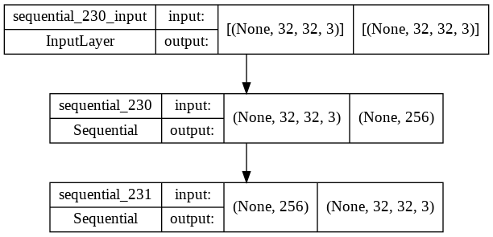
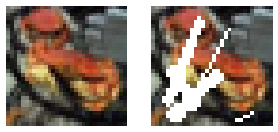
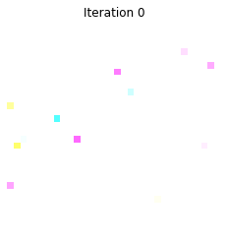
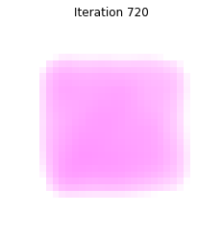
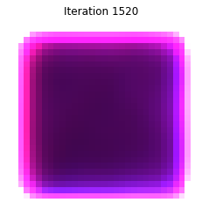
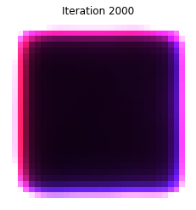
Auto-Encoder
Pconv
Wavemix
Deep image Prior
Conclusion
Problem Statement
Results on CIFAR100 Dataset
Fig 11: CIFAR100 Input Image for Image Inpainting using Deep Image Prior and its architecture
Fig 12. Results of Deep Image Prior on original dataset on 0th ,720th, 1520th and 2000th iteration

Slide 14
Auto-Encoder
Pconv
Wavemix
Deep image Prior
Conclusion
Problem Statement
Conclusion
Wavemix architecture using MAE loss performed best with a mean batch SSIM of 0.9477 with just 50 epochs.
Deep image prior did not work well on small data size of CIFAR100 (32x32x3). However it works well on larger images.
AdamW better than SGD
MAE better than MSE.
Other losses such as dice loss or cross entropy do not work well for image inpainting.
Partial convolution method well and with AdamW shows improvement over AutoEncoder method
Future Scope
Deep image prior - larger size
a combination of wavemix in deep image prior can be tested.
Wavemix looks promising for image based problems and can be tested on larger size images to compete with SOTA.

Slide 15
Thank You

